Slide 1
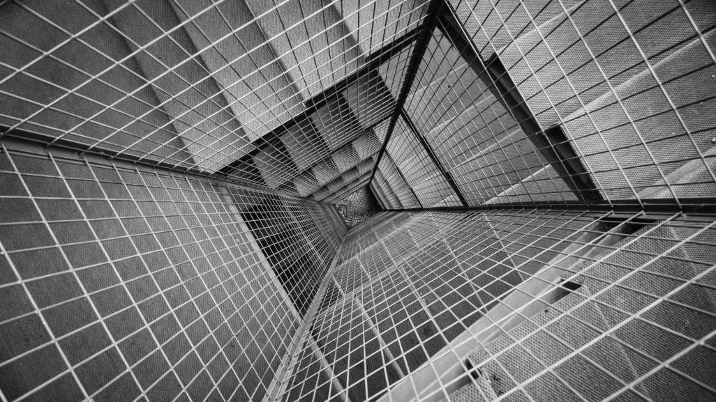
Quartet
2018.11.28
Dinmukhammad Rakhimov
Oybek Toshmatov
Sumit Shrestha
Yadnika Bhat Amit

Slide 2
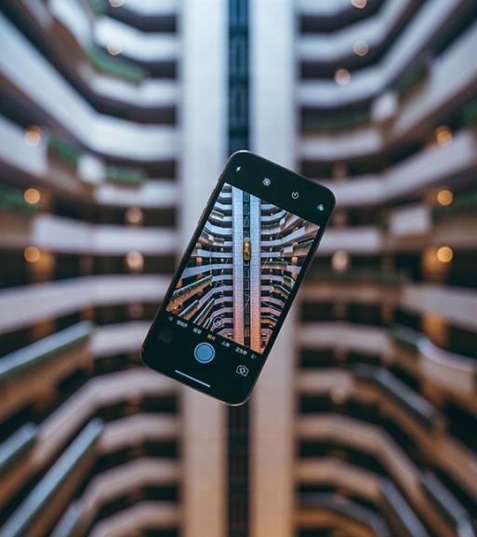
Raspberry Pi Wireless Communication
By Quartet

Slide 3

Wireless Communication
Dinmukhammad Rakhimov(Group leader):
Building Mobile Control App, Bringing all together
Oybek Toshmatov:
Heart Rate Device Building
Sumit Shrestha
Speed Device building
Yadnika Bhat Amit
Wireless Audio Device Building

Slide 4

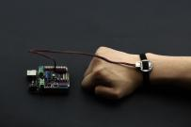
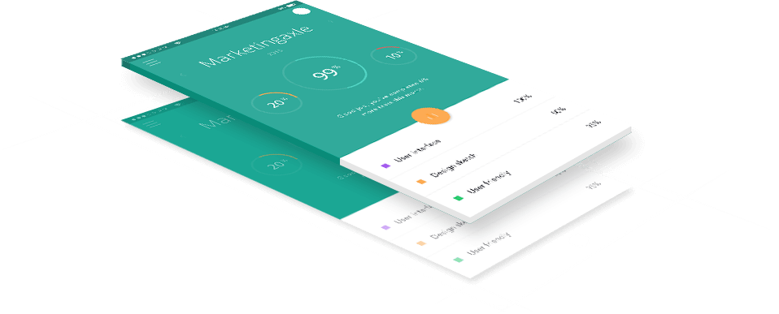


Introduction
Simultaneous Development

Slide 5


Mobile App Development
Using React Native
I have Built Mobile App for Controlling the whole wireless communications:
Framework: ReactNative
Libraries:
current-react-native-ble-manager
cancelled-Polidea/react-native-ble-plx
cancelled -react-native-wifi
Platform: Android/iOS
Testing: Android

Slide 6
Mobile App Development
current-BlenoNodejs module
current-react-native-ble-manager
In Client Side(Mobile App)
BLE(Bluetooth Low Energy) Device
Capable of connecting many devices at the same time.
Read(), Write(), Notify() functions to be used in our app
Read() to read data from the server side
Write() to write data to server side
Notify() to subscribe to some sensors to get the data when new data is ready in a certain time interval
In server side(in Raspberry Pi as Slave)
BLE(Bluetooth Low Energy) Device
Can not connect to many devices simultaneously
Consisting of Characteristics and services
Can Get data from client
Can send data to client
Can Notify client when new data is ready in a certain time interval

Slide 7
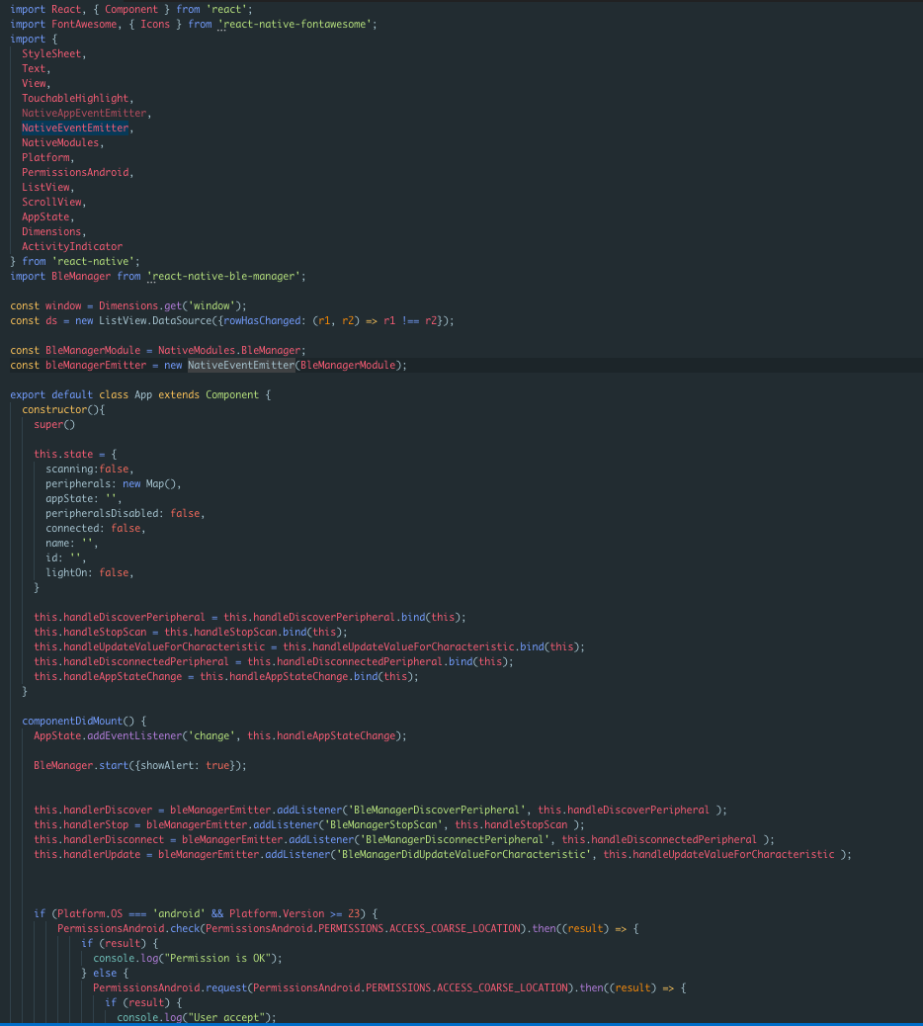
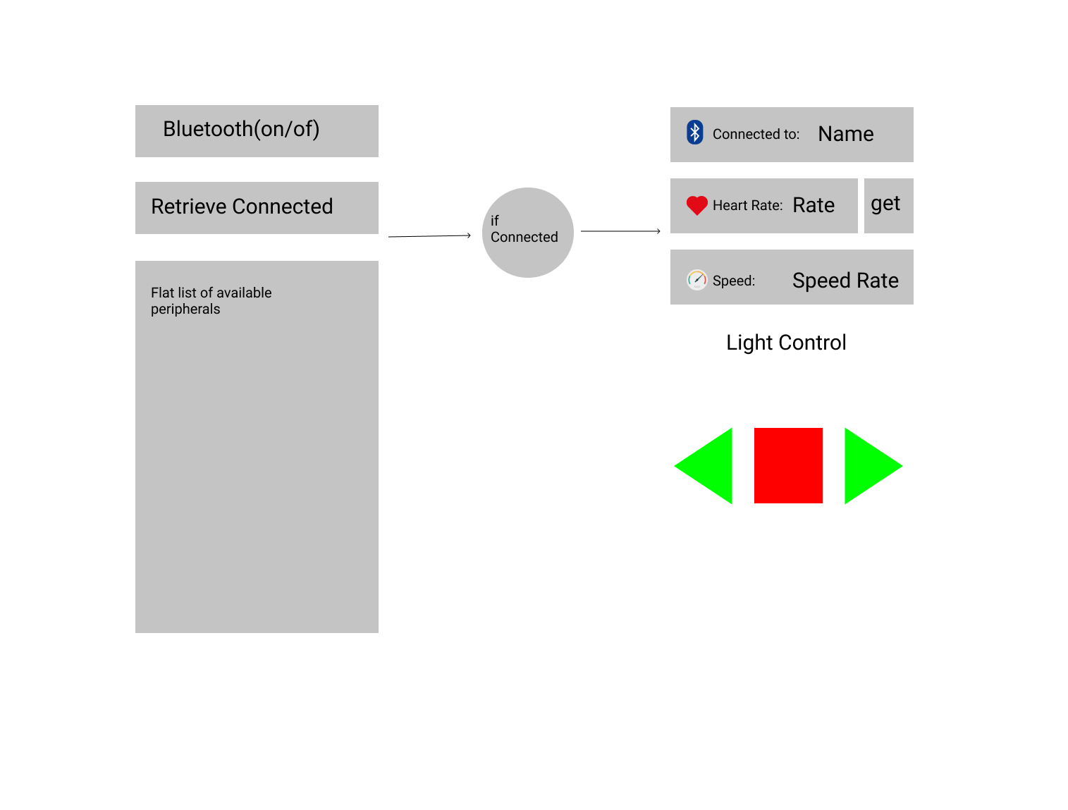
Overall Wireless Communication Architecture Client side

Slide 8
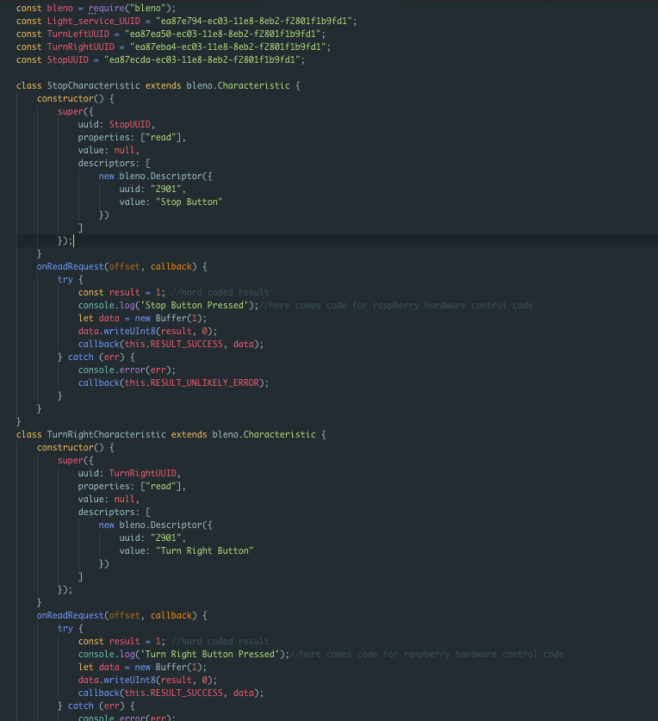
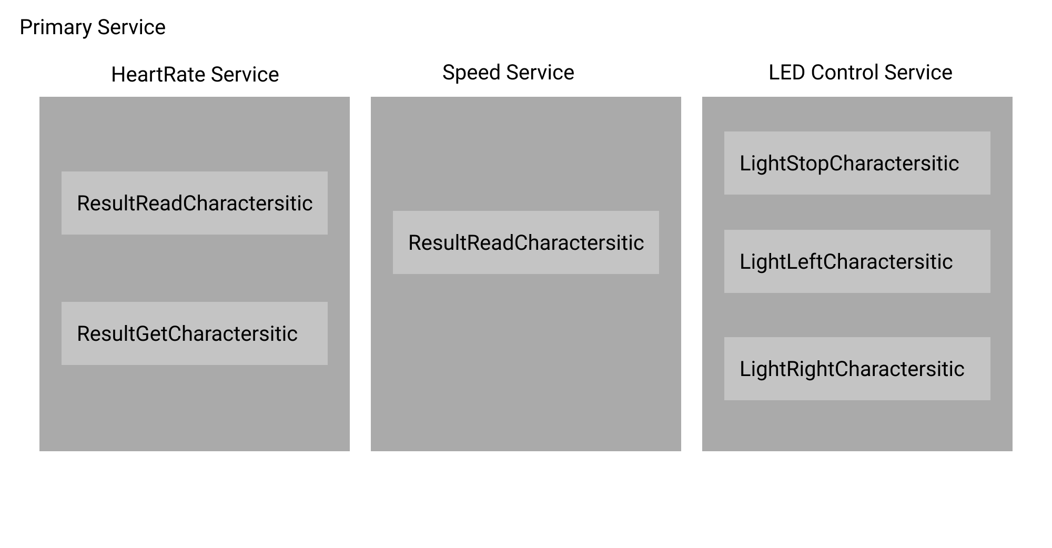
Overall Wireless Communication Architecture Server side

Slide 9
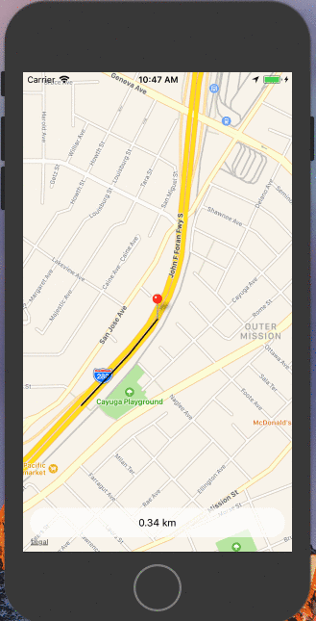
Raspberry Pi Geolocation
Cooperation with Legion

Slide 10
Raspberry Pi Wireless Communication and Geolocation
Online Resources: Just git clone
https://github.com/deenMuhammad/SmartHelmet.git
https://github.com/deenMuhammad/blenoexample.git
https://github.com/deenMuhammad/react-native-location-tracking.git
https://github.com/deenMuhammad/react-native-background-geolocation.git

Slide 11



THANK YOU Demo Time
Quartet
+8210-4038-2543
dinmuhammad.rahimov@mail.ru

